Slide 1
OOP PART 2

Slide 2
agenda
Encapsulation
inheritance
Class object
IS-a and has-a relationships
Polymorphism
Overriding and overloading
Constructors
Assignments and casting

Slide 3
Encapsulation
What is it?
HOW is it done?
Binding the data with the code that manipulates it
Keeping the data and the code safe from external interference
Wrapping up data members (state) and methods (behavior) together into a single unit (i.e. Class)
private instance variables
public Getters and setters to access hidden variables

Slide 4
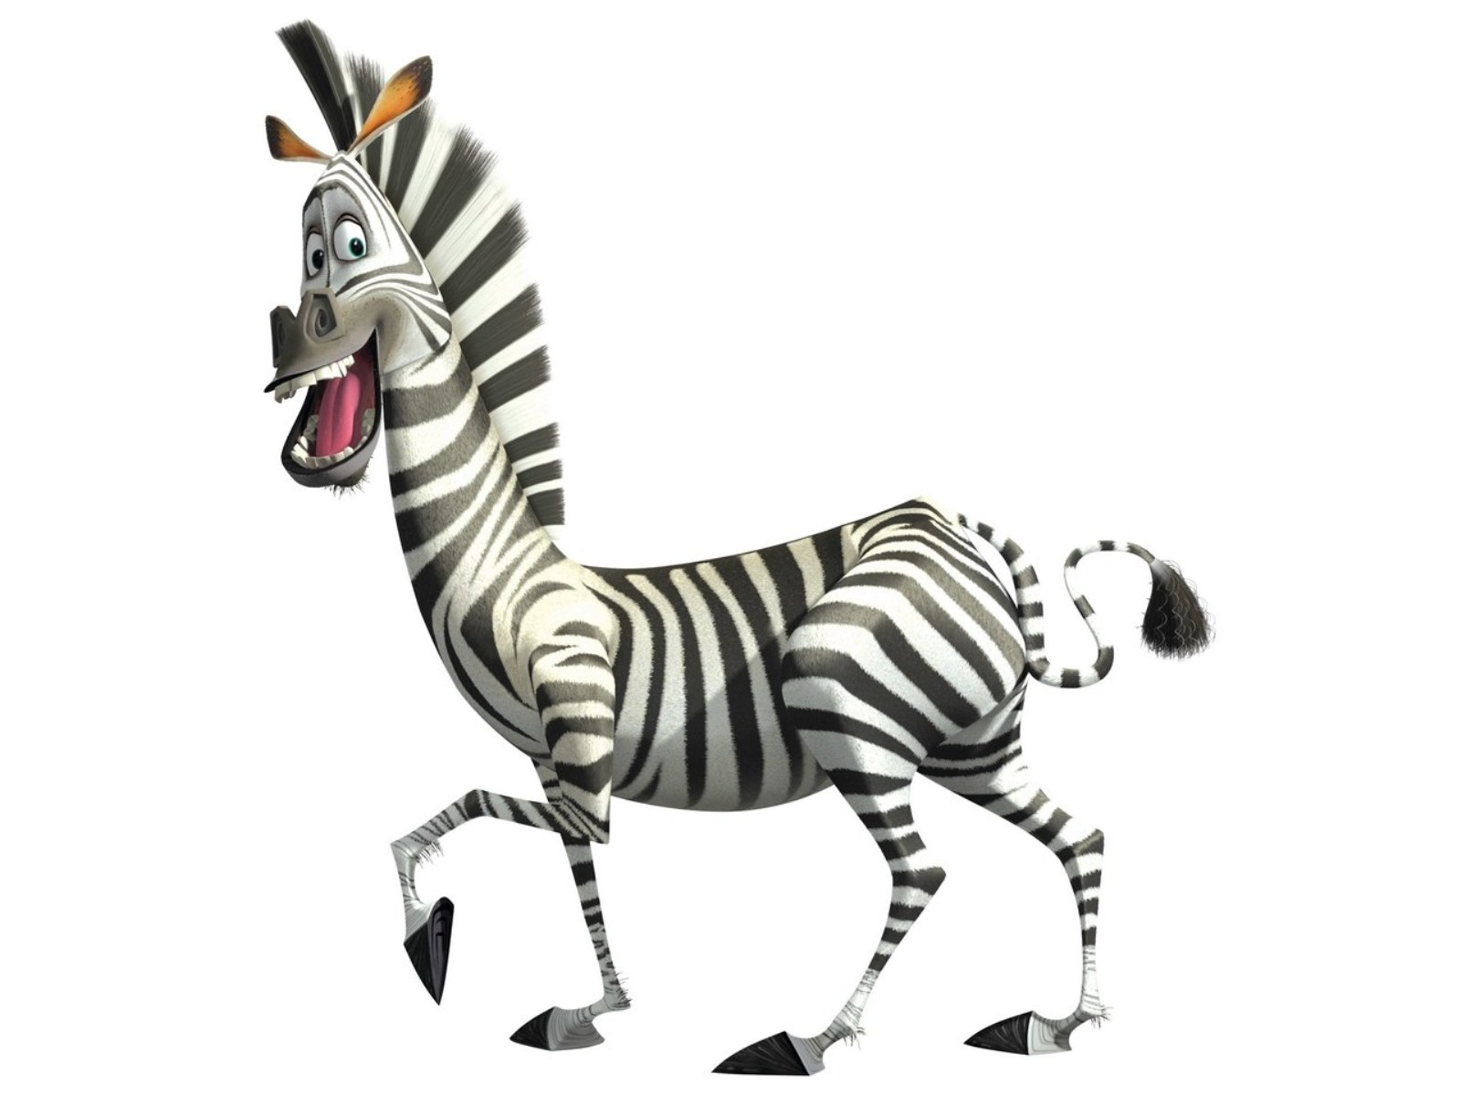
Encapsulation
State: weight, color, nickname, number of stripes
Behaviour: eat, sleep,
trot
Class = blueprint
Object = instance of a class
State = instance variables
Behaviour = methods

Slide 5
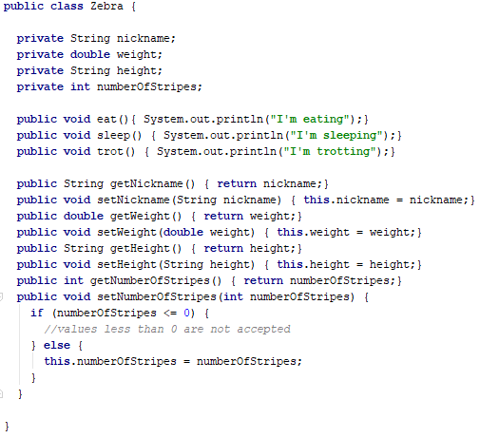
Encapsulation

Slide 6
agenda
Encapsulation
inheritance
Class object
IS-a and has-a relationships
Polymorphism
Overriding and overloading
Constructors
Assignments and casting

Slide 7
INHERITANCE
State: weight, color, nickname
Behaviour: eat, sleep
State: weight, color, nickname, number of stripes
Behaviour: eat, sleep,
trot
ANIMAL
parent
inherits
child

Slide 8
INHERITANCE
BENEFITS
HOW is it done?
Creates specialized objects without starting from scratch
Code reusability
Polymorphism
You can create inheritance relationships in Java by extending a class
A class that is derived from another class is called a subclass
A subclass inherits all of the public and protected members (fields, methods) of its parents (superclasses)
Java supports only single inheritance!

Slide 9
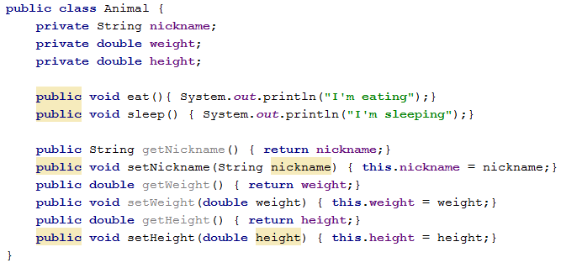
INHERITANCE

Slide 10
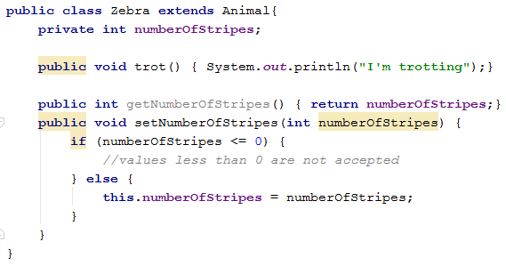
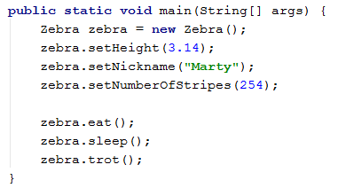
INHERITANCE

Slide 11
agenda
Encapsulation
inheritance
Class object
IS-a and has-a relationships
Polymorphism
Overriding and overloading
Constructors
Assignments and casting

Slide 12
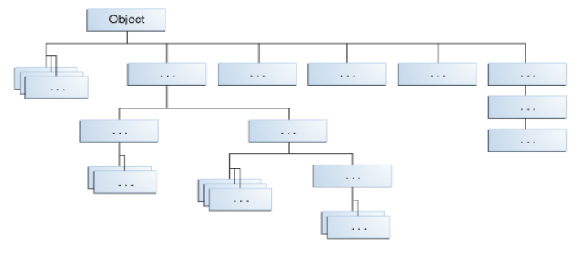
class object
Every class in Java is a subclass of class Object
The Object class, defined in the java.lang package, defines and implements behavior common to all classes

Slide 13
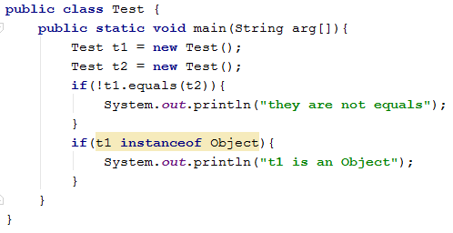

class object
output

Slide 14
agenda
Encapsulation
inheritance
Class object
IS-a and has-a relationships
Polymorphism
Overriding and overloading
Constructors
Assignments and casting

Slide 15
IS-a and has-a relationships
IS-a
The concept of IS-A is based on class inheritance
In Java the IS-A relationship is expressed through the keyword extends (for classes) and implements (for interfaces)
Mammal IS-A Animal
Zebra IS-A Mammal
Zebra IS-A Animal
ANIMAL
MAMMAL extends ANIMAL
ZEBRA extends MAMMAL

Slide 16
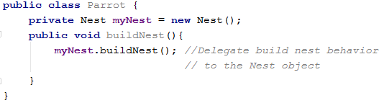
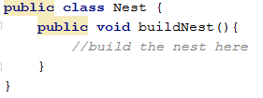
IS-a and has-a relationships
HAS-a
HAS-A relationships are based on usage, rather than inheritance
Class A HAS-A B is code in class A has a reference to an instance of class B
Parrot HAS-A Nest
Parrot
Nest n
buildNest()
Nest
buildNest()

Slide 17
agenda
Encapsulation
inheritance
Class object
IS-a and has-a relationships
Polymorphism
Overriding and overloading
Constructors
Assignments and casting

Slide 18
POlymorphism
Poly = many, morphos = forms
Any Java object that can pass more than one IS-A test is polymorphic
The ability to create methods or reference variables which behave differently in different programmatic contexts
The reference variable’s type (not the object’s type) determines which methods can be called (the rest are simply not visible)
The object type determines which method is actually called
Polymorphic method invocations apply only to instance methods, not static methods, not variables
Only overridden instance methods are dynamically invoked based on the real object’s type

Slide 19

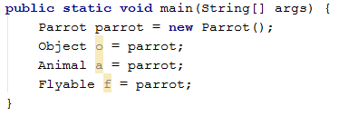
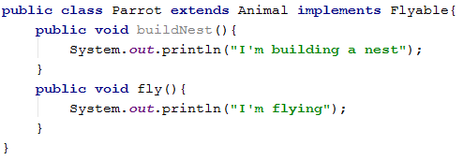
POlymorphism

Slide 20
agenda
Encapsulation
inheritance
Class object
IS-a and has-a relationships
Polymorphism
Overriding and overloading
Constructors
Assignments and casting

Slide 21
overriding and overloading
overriding
Overriding is the ability to define behavior that’s specific to a particular subclass type
The argument list in the overridden and overriding methods must be exactly the same
The return type of the overriding method can be a child class of the return type declared in the overridden method
The version of the overridden method is decided at runtime based on object type
The overriding method can not reduce the access scope of the overridden method. (same/wider access)
In Java private, static and final methods can not be overridden in any way

Slide 22

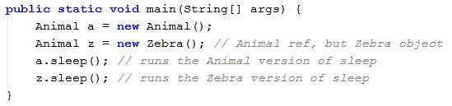
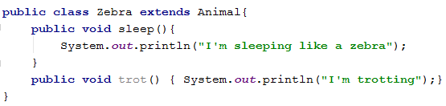
overriding and overloading
overriding

Slide 23

overriding and overloading
overloading
Overloaded methods let you reuse the same method name in a class, but with different arguments (and, optionally, a different return type)
Overloaded methods MUST change the argument list
Overloaded methods CAN change the return type
Overloaded methods CAN change the access modifier
The reference type (not the object type) – passed at compile time - determines which overloaded method is invoked

Slide 24
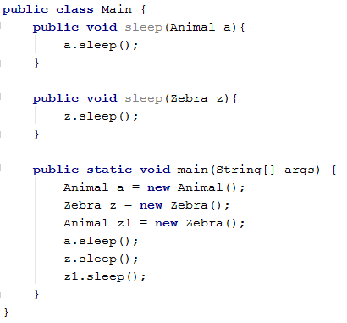
overriding and overloading
overloading

Slide 25
agenda
Encapsulation
inheritance
Class object
IS-a and has-a relationships
Polymorphism
Overriding and overloading
Constructors
Assignments and casting

Slide 26
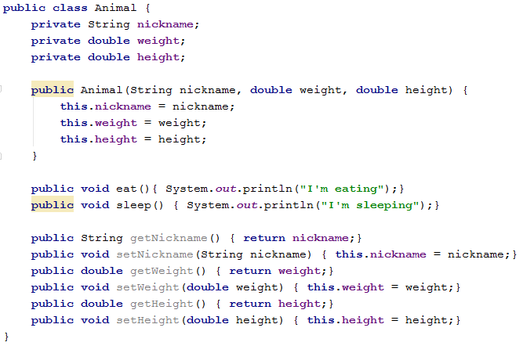
constructors
Super keyword
If a method overrides one of its superclass's methods, you can invoke the overridden method through the use of the keyword super.
super can be used to refer immediate parent class instance variables
The super keyword can also be used to invoke the parent class constructor

Slide 27
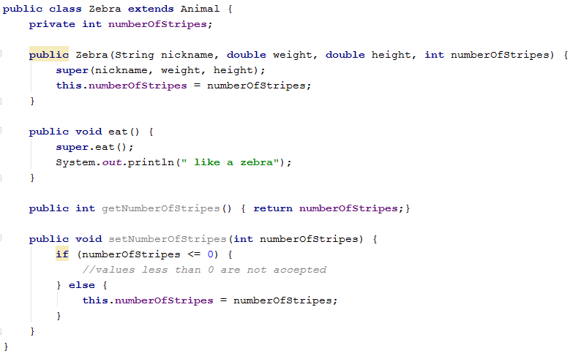
constructors

Slide 28
agenda
Encapsulation
inheritance
Class object
IS-a and has-a relationships
Polymorphism
Overriding and overloading
Constructors
Assignments and casting

Slide 29
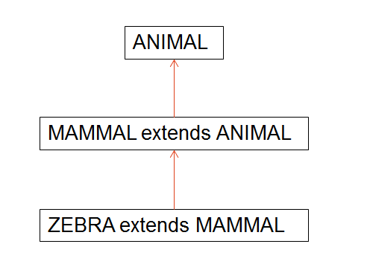
assignments and casting
If you have a reference variable that refers to a subtype object, you can assign it to a reference variable of the subtype. You must make an explicit cast to do this, and the result is that you can access the subtype's members with this new reference variable.
You can assign a reference variable to a supertype reference variable explicitly or implicitly.
It is an inherently safe operation because the assignment restricts the access capabilities of the new variable.
Zebra z = new Zebra();
Animal a = z;
Zebra z1 = (Zebra) a;

Slide 30
Thank you!

